Slide 1
Check-up

Slide 2
A
B
C
D
E
F
G
H
I
J
K
I want a….
_ _ _ _ _ _
C
O
O
K
I
E
L
M
N
O
P
R
S
T
U
W
Y

Slide 3
A
B
C
D
E
F
G
H
I
J
K
I want a….
_ _ _ _ _ _
B
A
N
A
N
A
L
M
N
O
P
R
S
T
U
W
Y

Slide 4
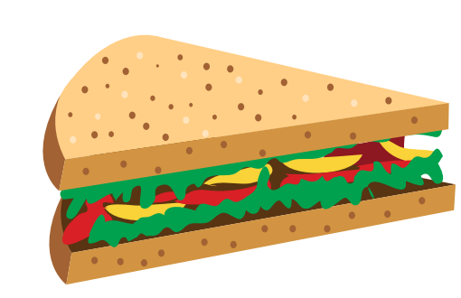
A
B
C
D
E
F
G
H
I
J
K
I want a….
_ _ _ _ _ _ _ _
S
A
N
D
W
I
C
H
L
M
N
O
P
R
S
T
U
W
Y

Slide 5
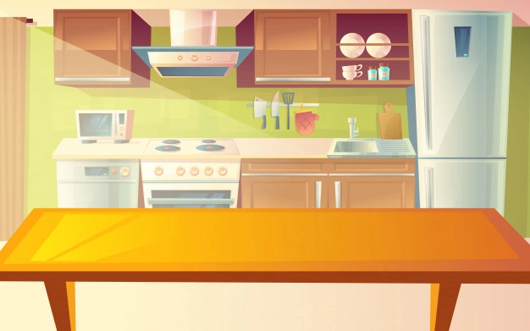
Review
banana
cookie
sandwich
Click on the picture to hear the word.

Slide 6
FOOD
UNIT 8
Lesson 1

Slide 7
Part D
Point and say.

Slide 8
Review structure
I want a banana.
Diễn tả ý muốn “Tôi muốn một quả chuối”

Slide 9
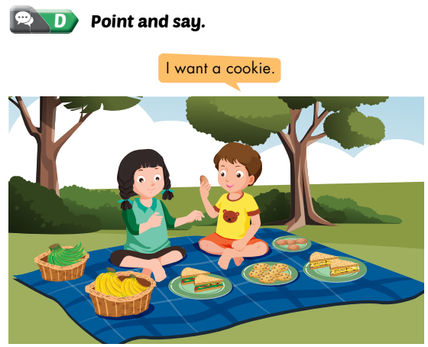
Point and say

Slide 10
PLAYTIME

Slide 11
ROUND 1
Find the matching pairs.

Slide 12
1
2
3
banana
sandwich
B
C
A
cookie

Slide 13
ROUND 2

Slide 14
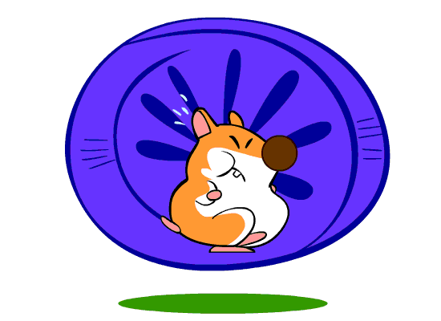
HAMSTER
GAME
Click and see where the hamster is moving to.
Then click on the gift that has the correspondent number

Slide 15
1
1
2
8
2
3
4
CLICK
7
3
5
6
6
4
5
7
8

Slide 16
I want a……
cookie

Slide 17
1
1
2
8
2
3
4
7
3
CLICK
5
6
6
4
5
7
8

Slide 18
I want a……
banana

Slide 19
1
1
2
8
2
3
4
CLICK
7
3
5
6
6
4
5
7
8

Slide 20
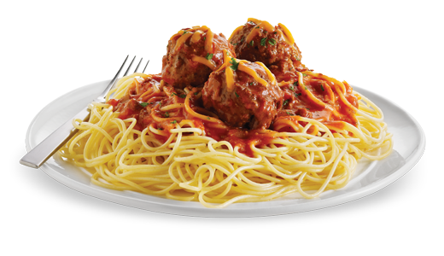

Slide 21
1
1
2
8
2
3
4
CLICK
7
3
5
6
6
4
5
7
8

Slide 22
Click the sandwich.

Slide 23
1
1
2
8
2
3
4
CLICK
7
3
5
6
6
4
5
7
8

Slide 24
I want a……
sandwich

Slide 25
1
1
2
8
2
3
4
CLICK
7
3
5
6
6
4
5
7
8

Slide 26
Click the banana.

Slide 27
1
1
2
8
2
3
4
CLICK
7
3
5
6
6
4
5
7
8

Slide 28
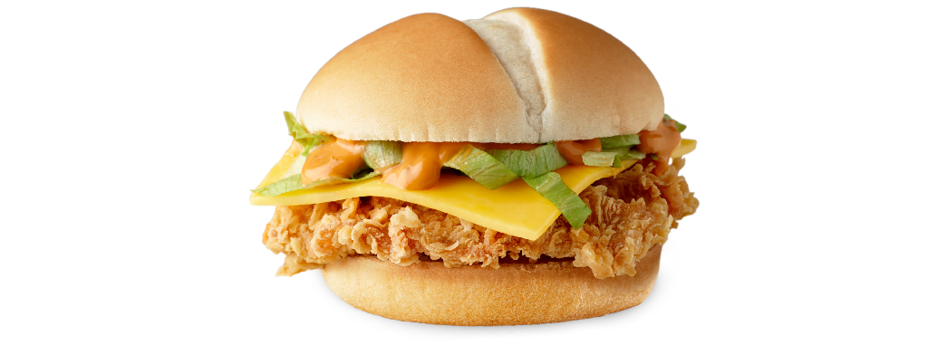

Slide 29
1
1
2
8
2
3
4
CLICK
7
3
5
6
6
4
5
7
8

Slide 30
Click the cookie.

Slide 31
THANK YOU

